Slide 1
Language and Tools for Establishing Influence as an Early-Career Statistician
Jessica Lavery, MS
Assistant Research Biostatistician
October 19, 2017

Slide 2
Outline
Intro
About me
Motivation for this talk
Tips & tricks
Setting expectations
Fostering a collaborative relationship
Effectively sharing results
Key takeaways & additional resources

Slide 3
Intro: About me
BS in statistics (2012) from Loyola University in Maryland
MS in biostatistics (2014) from UNC Chapel Hill
Experience primarily at large, academic medical centers in New York
Currently part of the Health Outcomes Research Group at Memorial Sloan Kettering

Slide 4
The medical field
Attending
Fellows
Residents
Medical students
Chief

Slide 5
Collaborative clinical research
Statistics
Science & Medicine

Slide 6
Research as (some) clinical collaborators see it
Science & Medicine
Statistics
Science
& Medicine

Slide 7
Research with an influential statistician
Statistics
Science & Medicine

Slide 8
Setting expectations
Collaborating
Sharing results

Slide 9

You will need to explain what you do

Slide 10

“This project/ analysis will be easy”

Slide 11
This project/analysis will involve … and I am looking forward to working on it.

Slide 12
Setting expectations
Collaborating
Sharing results

Slide 13

Use we instead of you

Slide 14
Follow your collaborator’s lead in terms of how you address them
(Dr. Slover vs Jim)

Slide 15

Don’t ask, tell

Slide 16

Offering to coordinate a meeting allows you to pick a mutual location

Slide 17
Repeat & approve
Notes:
Reference: Influence: Essential for Success as a Statistician, Paul Berg (AmStat News, September 2013)

Slide 18
Know when to bring in another statistician

Slide 19
“I’m just emailing to ask…”

Slide 20
I’m emailing to ask…

Slide 21
Setting expectations
Collaborating
Sharing results

Slide 22
Speak the same language as your collaborator

Slide 23

Summarize results at the top of a document. Provide additional details below

Slide 24

Do not send analyses immediately if there is no true deadline

Slide 25
Silence is okay

Slide 26

Key takeaways
Subtle tactics can greatly affect how collaborators view your role
It’s a learning process

Slide 27

Thank you!
Questions? Comments?
laveryj@mskcc.org

Slide 28





Additional resources: women in statistics

Slide 29
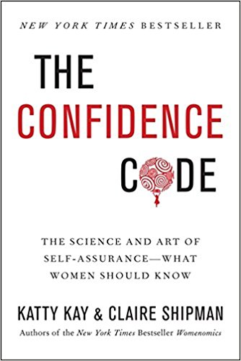
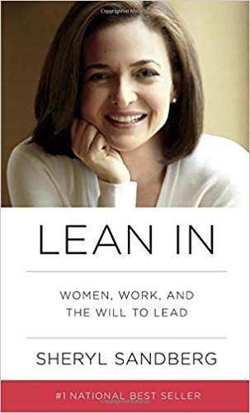

Additional resources: female leadership

Slide 30
Acknowledgements
Thanks to Melinda Seckington for posting her talk on The Art of Slide Design
All icons in talk downloaded from FlatIcon

